Slide 1
Video Template

Slide 2
Length of video :
15 minutes oral presentation
Submission email: igrsm.conf@gmail.com
Title : Paper ID_Paper Title
Please indicate Paper ID in file name and slide title page

Slide 3
Please start your presentation with:
'My name is__, Paper ID__ with the title of ___ .'
Please use the attached Powerpoint Template for your presentation slide.
Submission deadline : 14 September 2020

Slide 4
Download Zoom

Slide 5
Select 'New Meeting'

Slide 6
1.Unmute
2. Turn on
webcam

Slide 7
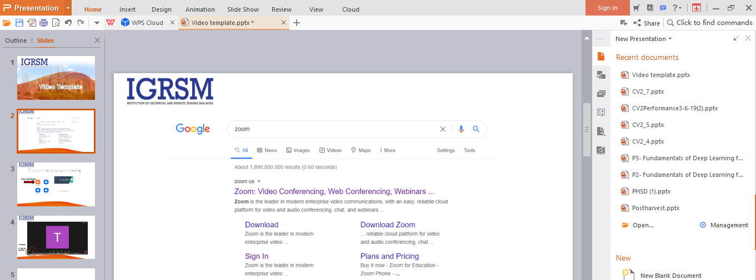

Slide 8
Click 'Share Screen'

Slide 9
Select your Powerpoint presentation
Click 'Share'

Slide 11
Top right corner or wherever you wish your video to appear
throughout the presentation

Slide 12
Drop-down Menu > More > Record

Slide 13
Stop recording

Slide 14
End Meeting

Slide 16
Auto-convert to mp4

Slide 17
Your video is here
***The size of video file can be reduced using http://www.videosmaller.com (Optional)

Slide 18
Note:
Please feel free to use any software that you are comfortable with(not necessary Zoom).
Please make sure your sound is clear.
Should you need any further information, please drop us an email @ igrsm.conf@gmail.com.
Thank You

